Slide 1
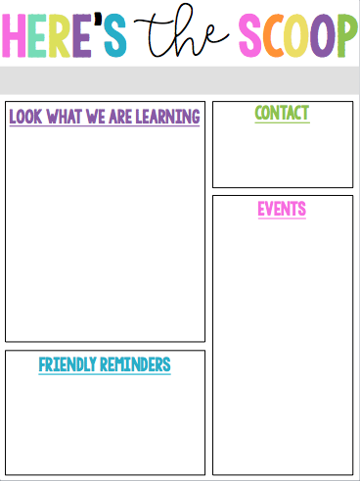
Mrs. Lee’s Class
Week of May 13th
ELA:
Figurative Language Project
Wax Museum written speech
Math:
Getting Ready for Grade 4
Tuesday 5/14 Test on Lessons 1-4 Getting Ready for Grade 4
Social Studies:
Wax Museum Project – written speech and preparing for the presentation
Mrs. Lee
lee.dawn@franklin-academy.org
fa-lee.weebly.com
5/17 Flashlight Friday
5/21 Field Day
5/22 Wax Museum
5/24 3rd Grade End of Year
Party/May Birthday celebration
Please make sure your child completes 45 minutes of math and 45 minutes of reading lessons each week. We will be taking students to the computer lab each week beginning mid-September and they will be able to complete some of their minutes at that time. Students will receive a classwork grade for math and reading based upon completion of the 45 minutes.
Please make sure your
child is practicing with
the multiplication
flash cards!

