Slide 1
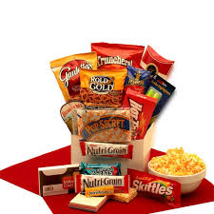
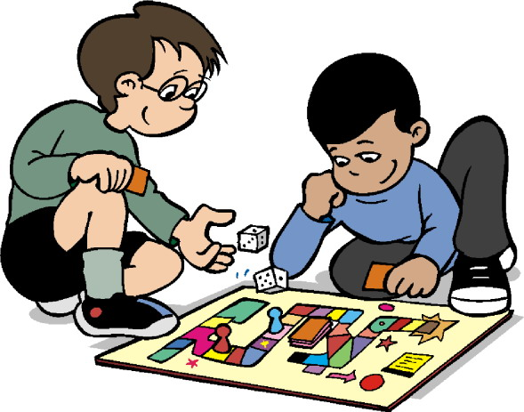
LAST WEEK OF 3RD GRADE
Monday 5/27:
No School (Memorial Day)
Tuesday 5/28:
Fort Day: Students may bring a small blanket, flashlight and a rated G movie. You may send in a snack for the class.
Wednesday 5/29:
Game Day: Students may bring in board games to play (no electronics, please).
Thursday 5/30
Movie Day: James and the Giant Peach. Students are allowed to bring a small blanket and stuffed animal. You may send in a snack for the class.
Friday 5/31:
Last Day of School: Students may bring rated G movies and board games.

